Slide 1












Roey Fabian, Ron Sharabi, Amit Cohen, Eren Fishbein
Vox Populi Platform
Open-source framework
for data collection from
encrypted social networks
Supervisor: Dr. Nir Grinberg

Slide 2







Goal
To develop a platform that enables the collection of private information in
Hebrew from various platforms with
different communication protocols, and
make the platform accessible as open-source

Slide 3


!
Anonymization
The model is finished
& ready for testing and integration
Project’s Status
Before marathon
The system received a maintenance update to enhance its recoverability.
Connection to all platforms.
Extraction of messages from whatsapp.
System
UI
Web app went live

Slide 4
Marathon’s Goals
Extraction of messages from Telegram & Signal
Creating a Database in Mongo
Saving messages into Mongo DB
Implementing anonymization before message logging
Connection to web app

Slide 5



Chat Processing
I
Regex
Anonymization
Dictabert NER
Entity Dictionary

Slide 6
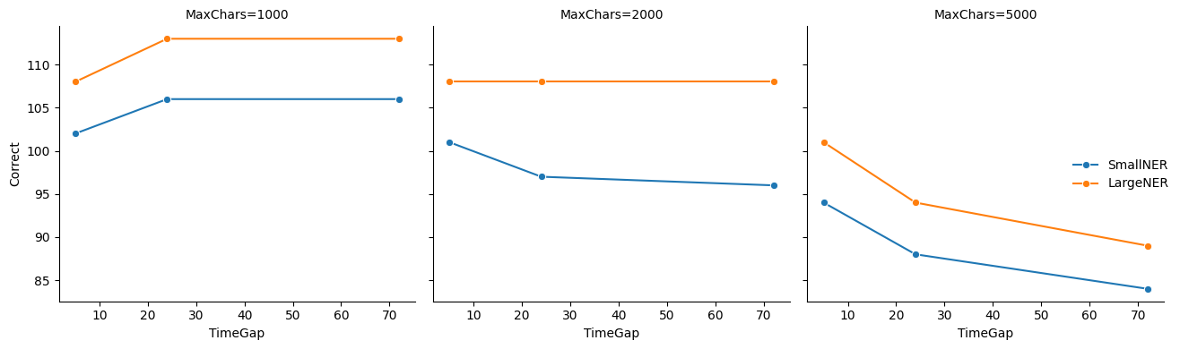
Phase 1 Summary

Slide 7


Dictionary Enhancements
(Name Detection)
Added each newly found name to a dynamic dictionary during processing
Performed a second pass using the full dictionary after the initial run.
Included Hebrew prefix variations like
"כש", "ל", "מ", "ו", etc.
Enforced word-boundary constraints
to avoid partial matches

Slide 8
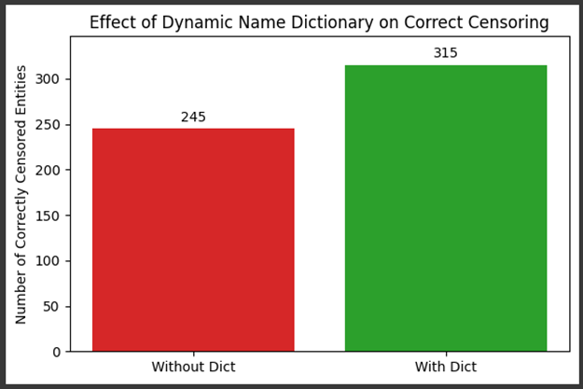
Adding 70 Entities via the Dictionary

Slide 9
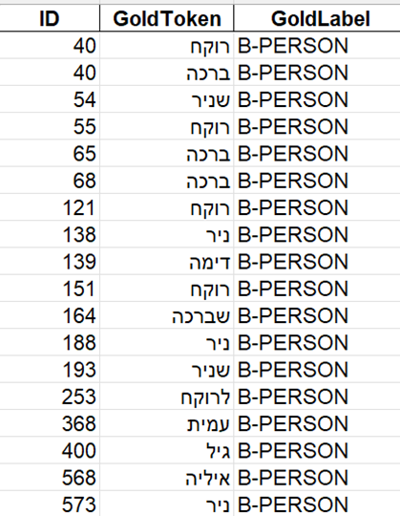
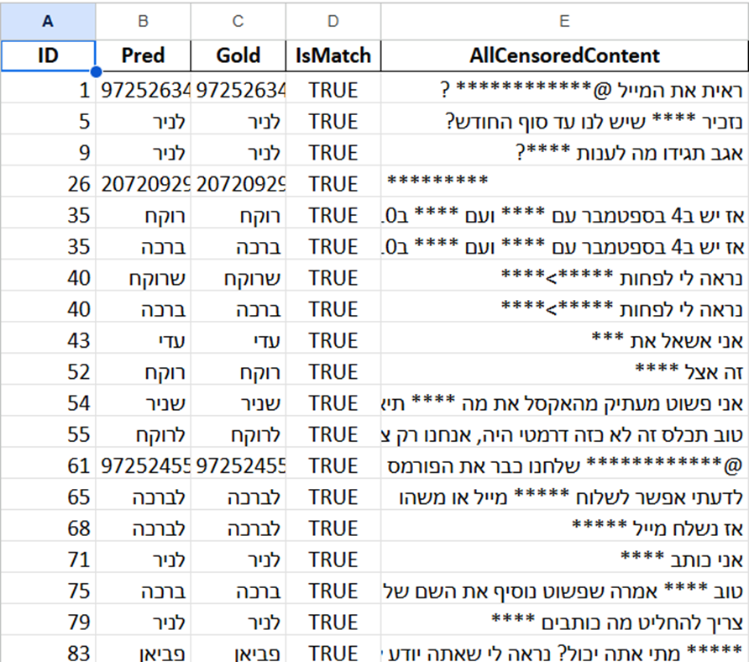
Missed Before
Example

Slide 10
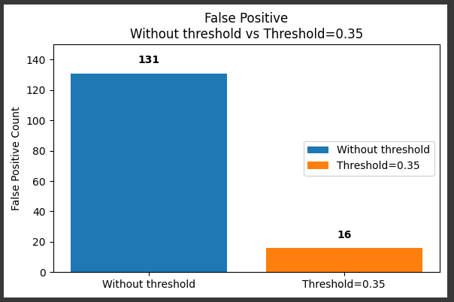
The Problem of Double Meanings in Hebrew

Slide 11
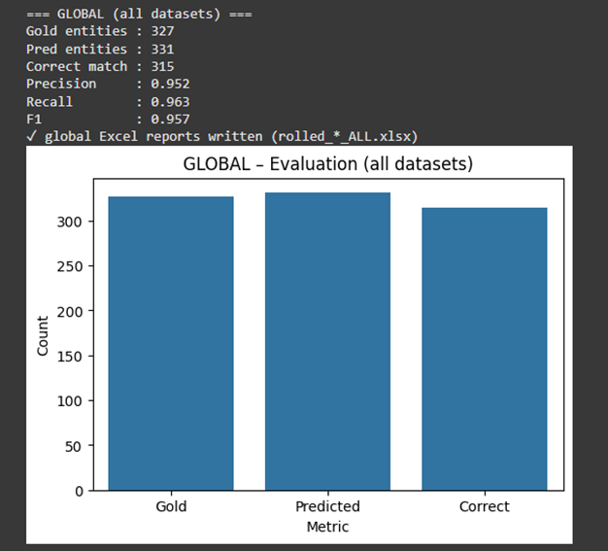
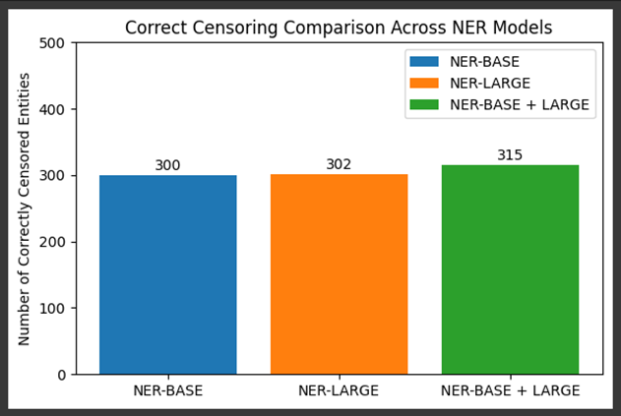
Merging the Models
only 12 missed Out of 327
95.7 F1 Score

Slide 12
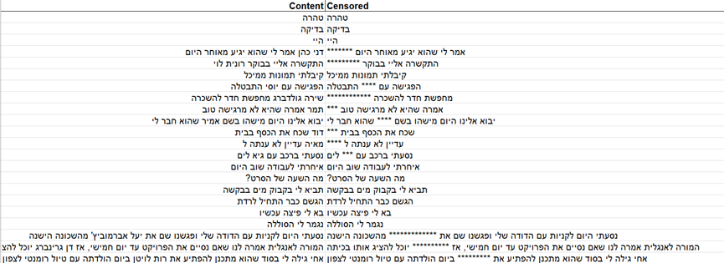
27 Out of 28 entities

Slide 13

Next Steps:
Implementing the anonymization before logging the messages
Red Teaming - synthetic chat for ‘attacking’ our model
fine tuning
Potential Improvements & What’s Next

Slide 14
II
System

Slide 15

Feature | Implemented
Infrastructure as code(robustness)
Message reading client
Connection to all platforms
Message logging

Slide 16

Feature | Implemented
Chat filter
Extracting groups names
Extracting user names

Slide 17
What’s next?
Web app integration
Anonymization integration

Slide 18
III
User Interface

Slide 19
Log In
Feature | Implemented
Role Selection
Login System
Platform Overview

Slide 20
Researcher
Feature | Implemented
User Management
Projects Overview
Project Creation
Chat Analysis
Data Exportation

Slide 21
User
Feature | Implemented
Chats + Chats Picker
Chat Start Date
QR Code
Deactivate account

Slide 22
Overall
Feature | Implemented
Connection to Mongo
Registration using element

Slide 23
TASK / PROCESS
24.4
4.5
8.5
9.5
22.5
1.6
15.6
20.6
26.6
Anonymization
FINE TUNING
System & DB
CHATS EXPORT
Web App
DATA INTEGRATION
DATA ANALYSIS
PROJECTS DAY
Platform
PILOT
TESTING
GOAL STRETCH
TESTING

Slide 24


thank you!

